Slide 1
Power BI in the Wild
Power BI at Innovative Architects
Julie Smith
March 18, 2017

Slide 2
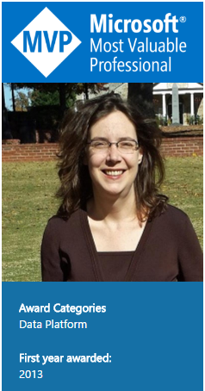
Julie Smith
@JulieChix
Datachix.com
Julie.smith@innovativearchitects.com
Notes:
Current Events.

Slide 3
Agenda:
Go over parts of Power BI
Fun Demo
Q & A
Notes:
Current Events.

Slide 4
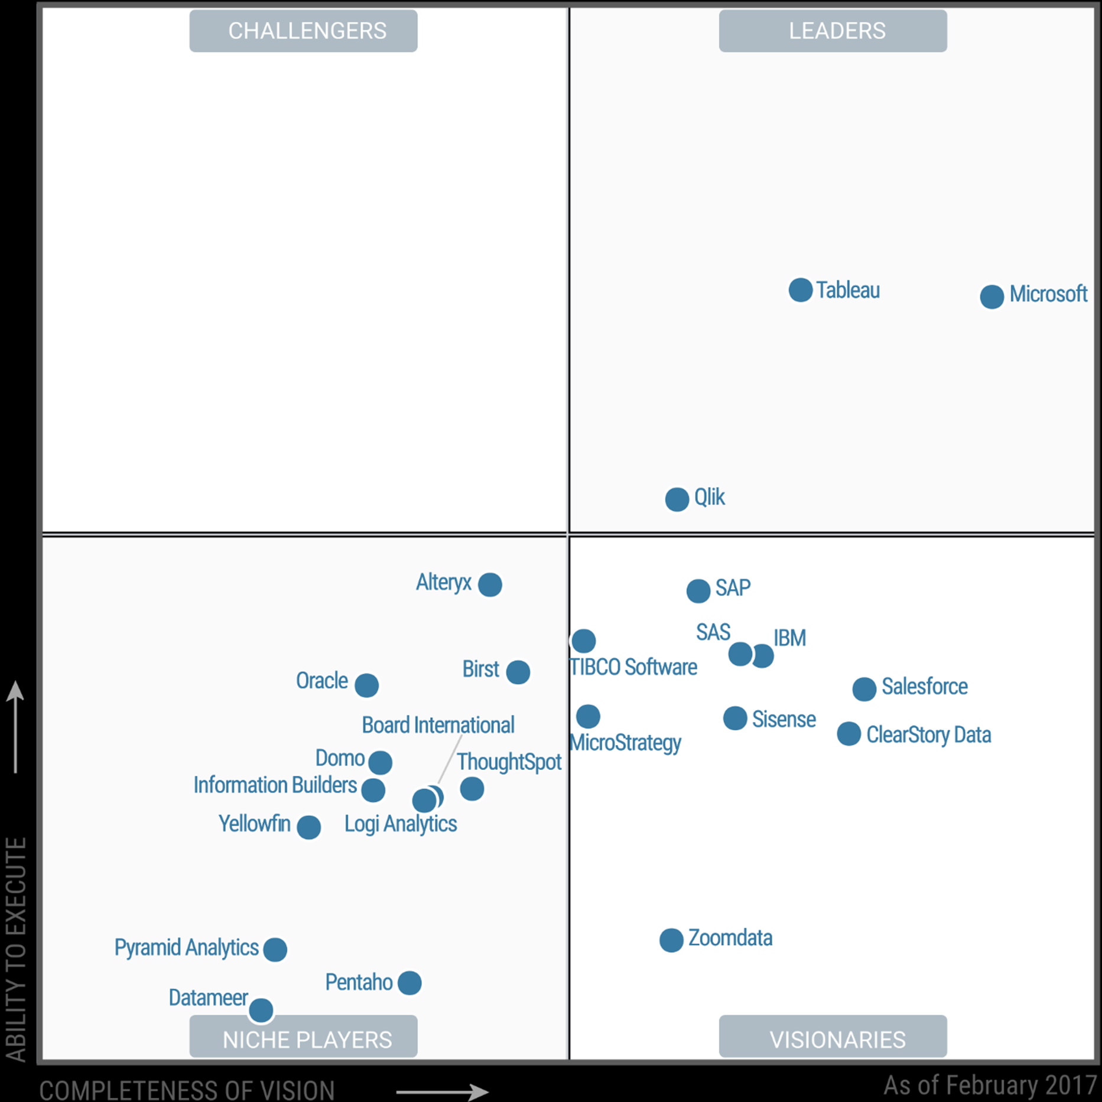
Being aware of Power BI
Overview of Power BI Capabilities
All info is as of March 13, 2017 and subject to rapid change.

Slide 5
For Lunch Today
What is Power BI?
What are licensing/pricing models?
Is Power BI Cloud only?
What are methods of sharing reports?
How are reports refreshed?
**All info is as of March 13, 2017 and subject to rapid change.

Slide 6
A Word of Inspiration
Nobody can be an expert on all things. That’s never been more true than it is today with this technology. So just go for it.
Notes:
Nobody can be an expert. That’s never been more true than it is today with this technology. So just go for it.

Slide 7
What is Power BI?

Slide 8
Power!
The Marketing Buzz
Cloud-based business analytics service
Dashboards
Reports
Visualizations
Q&A
Any data, anywhere, anytime
Cloud!
Mobile!

Slide 9
Power!
Human Speak
Fast.
Self Service-y for Power Users
Creating tiles that interact, presentation ready.
Cloud!
Mobile!

Slide 10
PBI is a Bundle of Services, Apps and Tools:
Power!
Power BI Service (powerbi.com, SaaS)
Power BI Desktop – free Windows app for self-service data analytics – All the Powers That Excel, for free with a bumble bee coating
Power BI Mobile – apps for iOS, Android, and Windows
Power BI Custom Visualizations – Open source, based on D3
Power BI Embedded – an Azure service for integrating Power BI reports in custom apps (uses Azure and iframes)
Power BI in SSRS 2016 Preview—On Premises version.
Notes:
Premise for this slide from original deck here: From Slideshare, Teo Lachev and Brian Jackson (http://bit.ly/2lgLvGP):

Slide 11
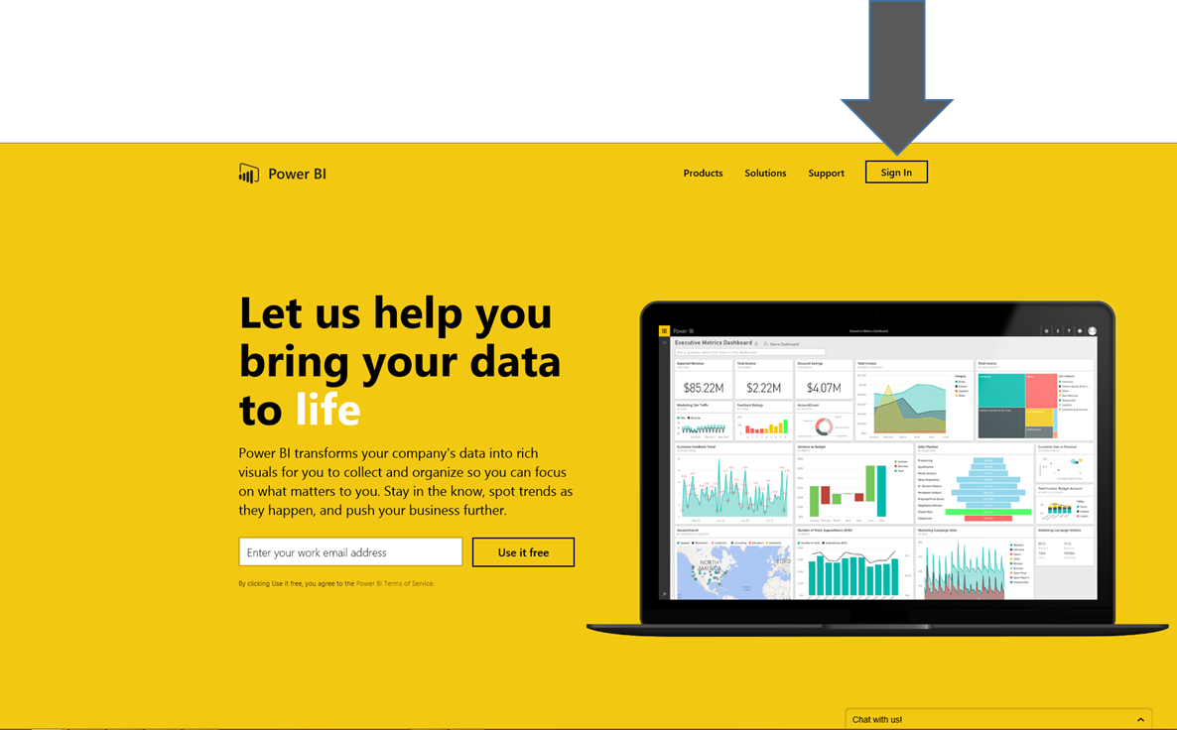
Getting Started
Power!
PowerBI.com
Click Sign In
Sign up.
Notes:
From Slideshare, Teo Lachev and Brian Jackson (http://bit.ly/2lgLvGP):

Slide 12
Is It Just That Easy???
Power!
Pretty enmeshed with O365
Hard to do much of anything without Pro Licenses.
Notes:
From Slideshare, Teo Lachev and Brian Jackson (http://bit.ly/2lgLvGP):

Slide 13
Pricing

Slide 14
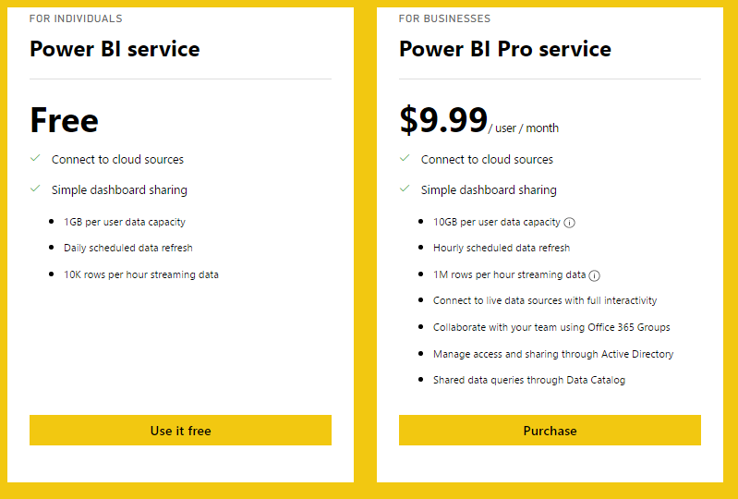
Pricing
Power!
Volume discounts available
Notes:
From Slideshare, Teo Lachev and Brian Jackson (http://bit.ly/2lgLvGP):

Slide 15
Getting Started—Pricing of Embedded
Power!
https://azure.microsoft.com/en-us/pricing/details/power-bi-embedded/#
Notes:
From Slideshare, Teo Lachev and Brian Jackson (http://bit.ly/2lgLvGP):

Slide 16
Getting Started—Pricing of PBI in SSRS 2016 To be Announced……
Power!
Notes:
From Slideshare, Teo Lachev and Brian Jackson (http://bit.ly/2lgLvGP):

Slide 17
Power BI Service

Slide 18
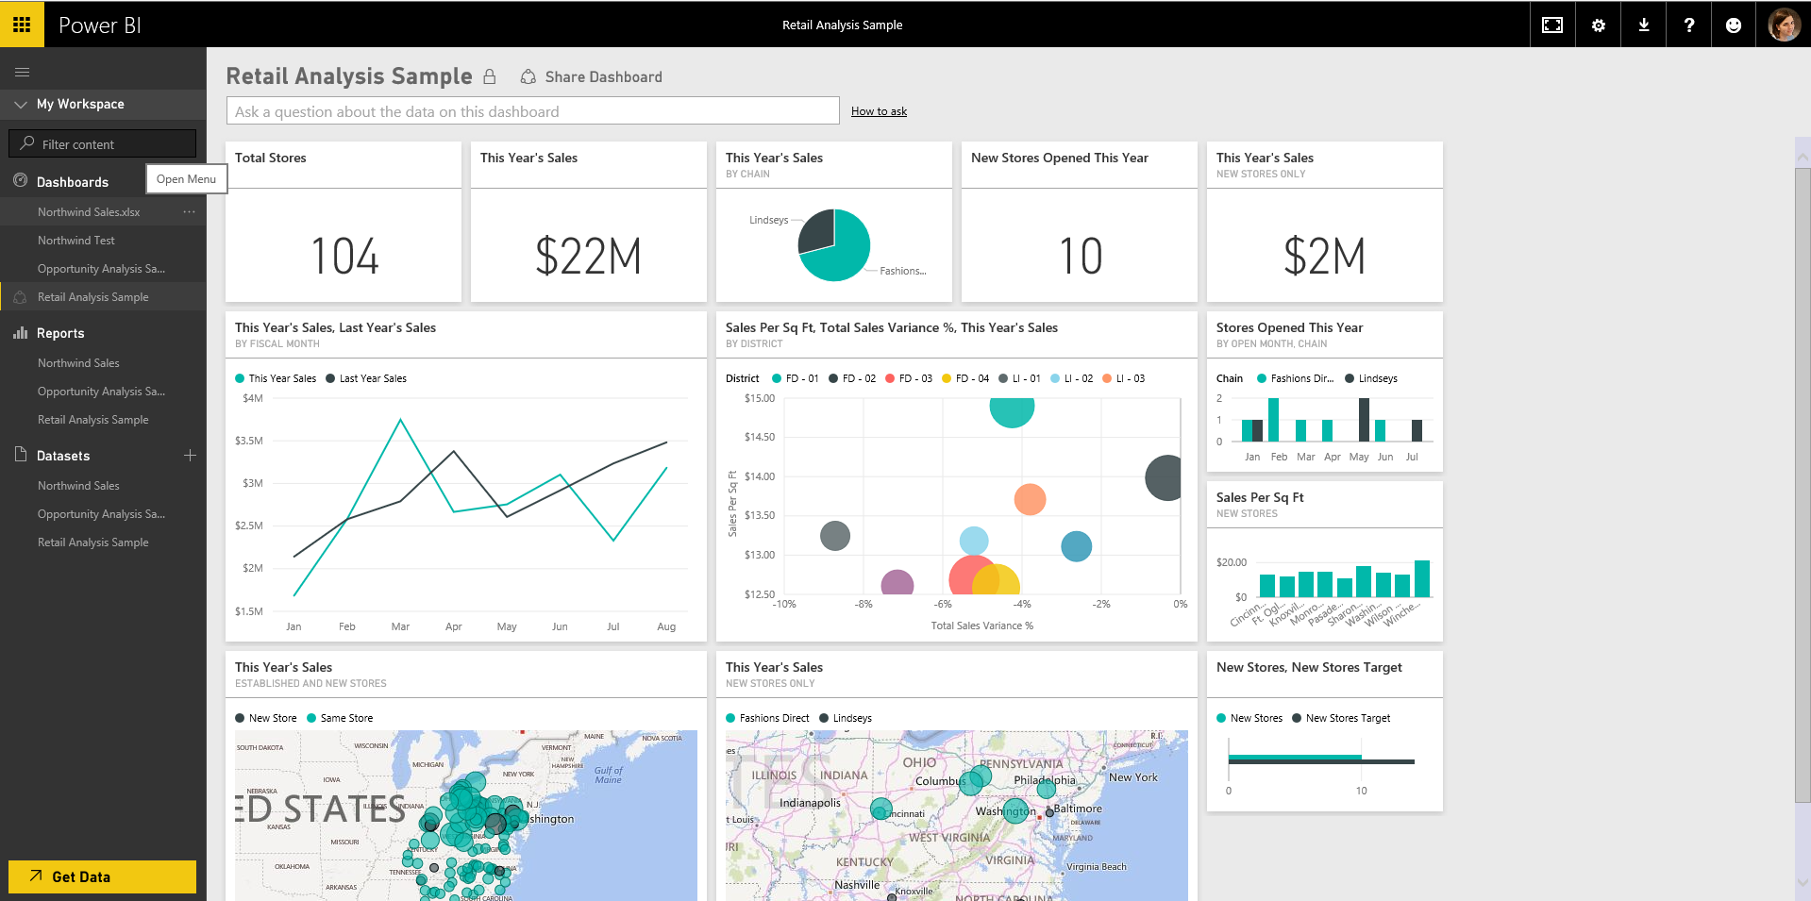
Retail Analysis Sample

Slide 19
Important Parts—The Service
Share DshBd
Q&A
DshBd
Tiles
Reports
Datasets
Notes:
Tiles--visualizations
Datasets – can be reused across multiple dashboards and reports
Reports – where you build your visualizations –can do it here, but limited. Don’t do it here.
Dashboards – like a mobile app. Stream all reports vertically. How you share outside org.
Get Data – go connect to native sources or your own
Workspace chevron—
Get Data

Slide 20
Administrative Elements of Service
Gateways (Which are necessary for refreshing data)
Setting up data refreshes
Implementing Role Level Security (Mapping roles to users and groups)
Workgroups (security groups)
Content packs
Notes:
Tiles--visualizations
Datasets – can be reused across multiple dashboards and reports
Reports – where you build your visualizations –can do it here, but limited. Don’t do it here.
Dashboards – like a mobile app. Stream all reports vertically. How you share outside org.
Get Data – go connect to native sources or your own
Workspace chevron—
Get Data

Slide 21
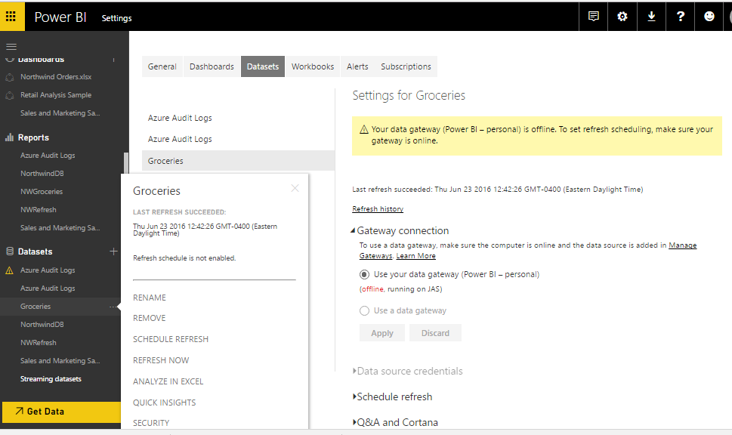
Important Parts—The Service–Gateways
Notes:
Tiles--visualizations
Datasets – can be reused across multiple dashboards and reports
Reports – where you build your visualizations –can do it here, but limited. Don’t do it here.
Dashboards – like a mobile app. Stream all reports vertically. How you share outside org.
Get Data – go connect to native sources or your own
Workspace chevron—
Get Data

Slide 22
Power BI Desktop

Slide 23
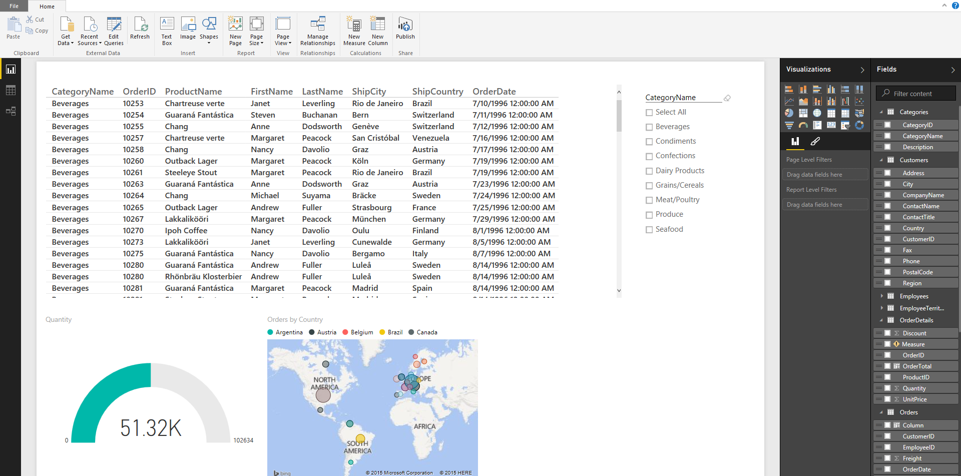
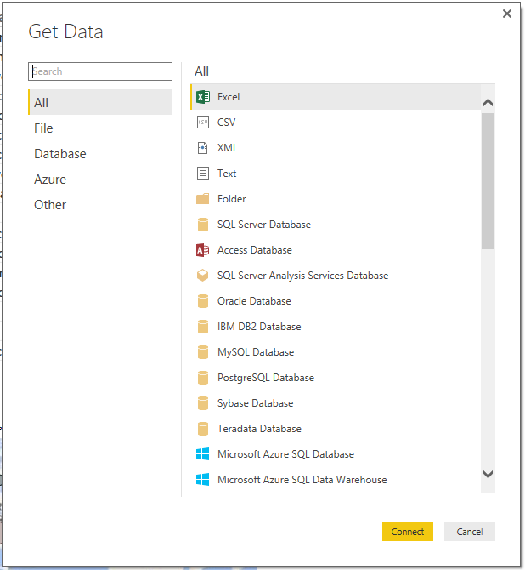
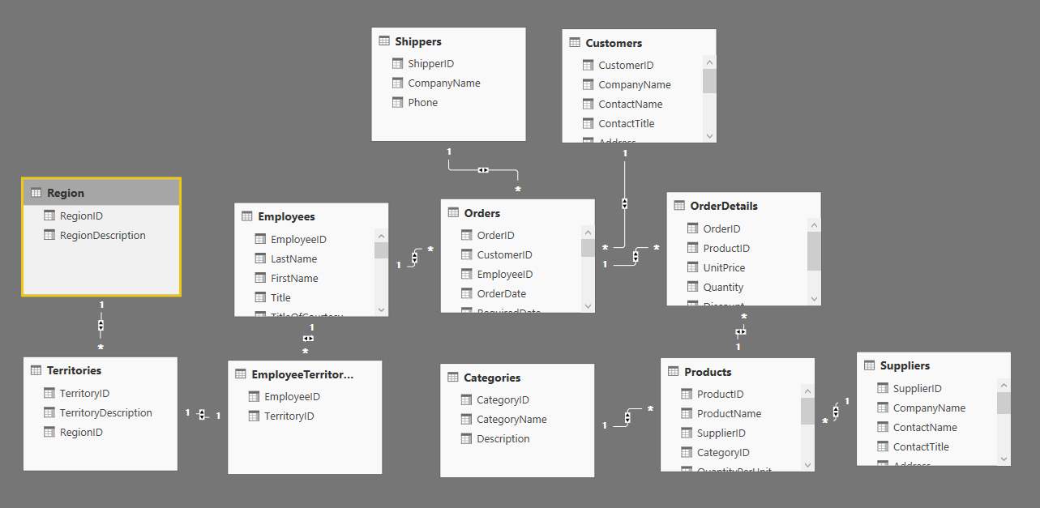
Power BI Desktop
Free tool
Author reports
Model & shape data
DAX support
Publish to Power BI Service
Notes:
From Slideshare, Teo Lachev and Brian Jackson (http://bit.ly/2lgLvGP):

Slide 24
Power BI Desktop --Aliases
Power Pivot
Power View
Power Query
And BTW, you’re not crazy about this:
Power Query
Power Pivot Dax
Notes:
From Slideshare, Teo Lachev and Brian Jackson (http://bit.ly/2lgLvGP):

Slide 25
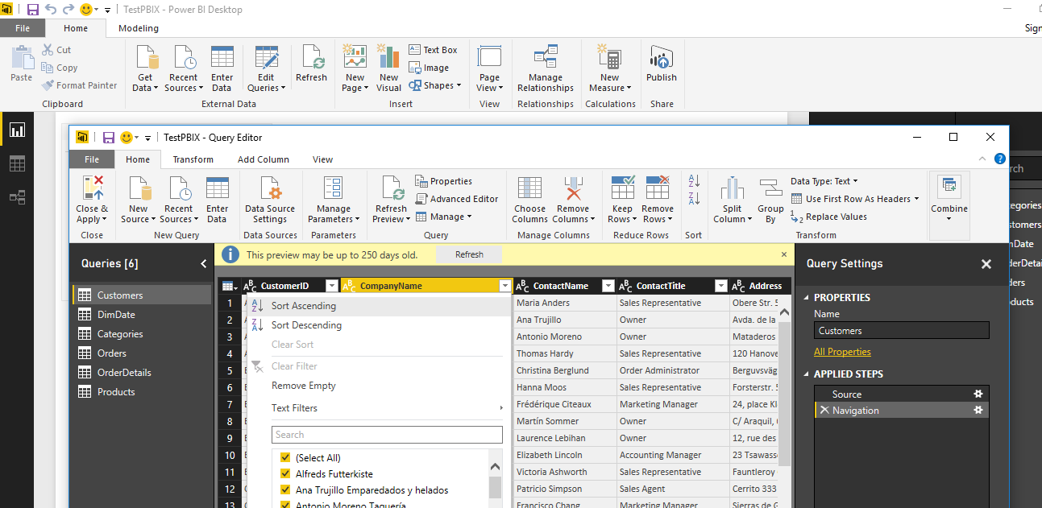
Power BI Desktop –Power Query
Notes:
From Slideshare, Teo Lachev and Brian Jackson (http://bit.ly/2lgLvGP):

Slide 26
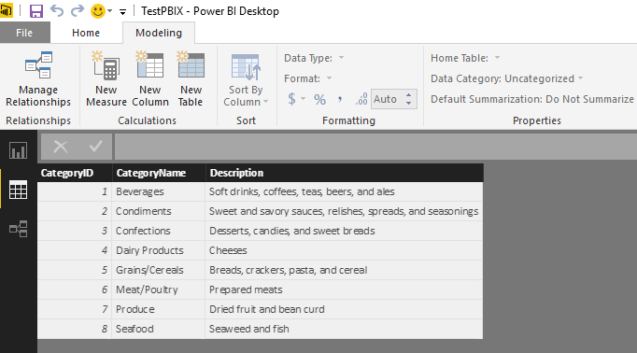
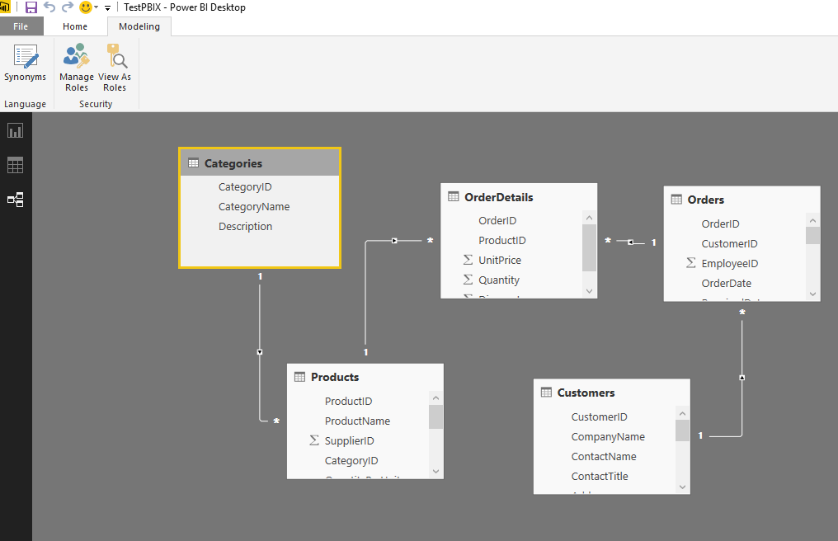
Power BI Desktop –Power Pivot
Notes:
From Slideshare, Teo Lachev and Brian Jackson (http://bit.ly/2lgLvGP):

Slide 27
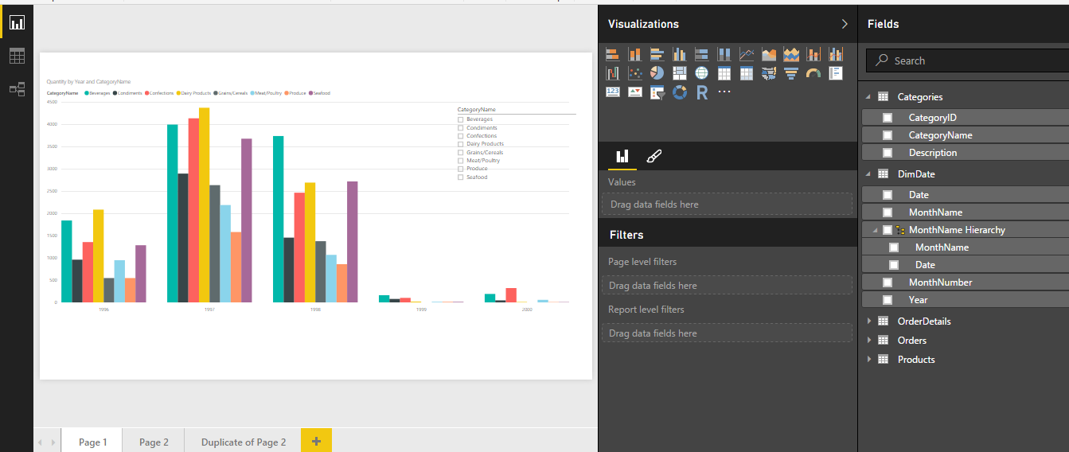
Power BI Desktop –Power View
Notes:
From Slideshare, Teo Lachev and Brian Jackson (http://bit.ly/2lgLvGP):

Slide 28
VertiPaq—It’s all the same thing!
Soheil Bakshi
PowerBI
Power Pivot
SSAS Tabular
=
=

Slide 29
Features available in Power BI Desktop
Hierarchies
Joins
Measures (Dax)

Slide 30
Word on Visualizations

Slide 31
Don’t Forget the Goal

Slide 32
Easy to Understand Data

Slide 33
Easy to Understand Data
Four chart Types to use:
Bar or column (not stacked. That goes to area)
Line charts
Scatter charts
Tables
Avoid Pie Charts and Pie Chart Variations (although many people love them and if your client does, I’m ok using them)

Slide 34
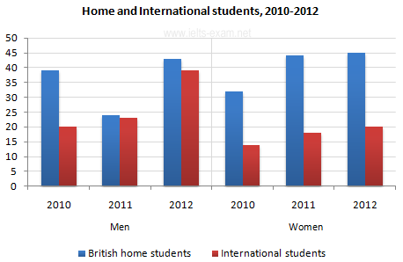
Bar and Column Charts

Slide 35
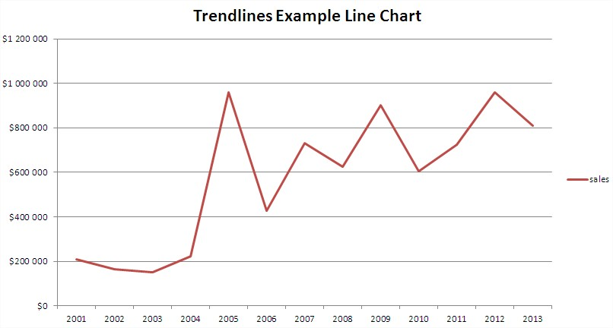
Line Charts

Slide 36
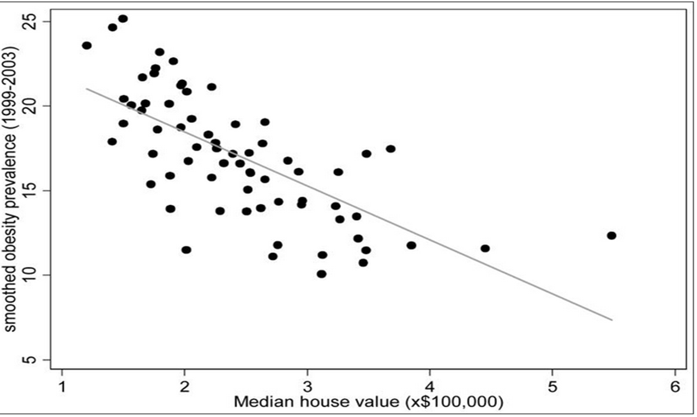
Scatter Chart

Slide 37
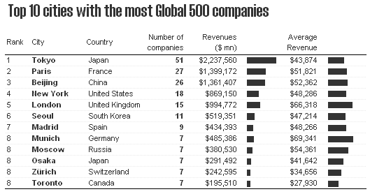
Tables

Slide 38
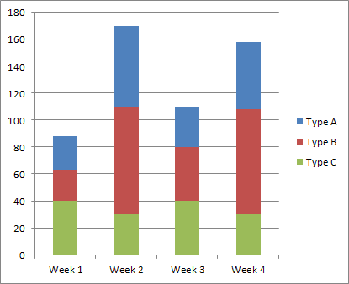
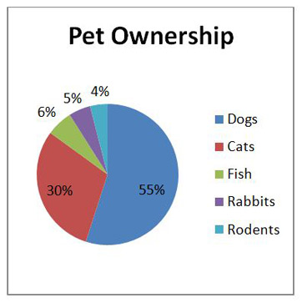
Area Perceptions--No

Slide 39
Sharing and Security

Slide 40
Sharing and Security
Power BI users inside or outside of your organization:
You can share a dashboard, not the reports or datasets directly
**our experience has been this is buggy sharing externally.
All Pro content contextual

Slide 41
Refresher: parts of PBI

Slide 42
Sharing and Security
Power BI Users Inside your organization:
You can have administrator create and manage Power BI workspaces, which are Office 365 Groups.
You can share content packs in order to share reports or datasets.
You can share Power BI via SharePoint Web parts
Row level security (based on AD Roles) can be utilized.

Slide 43
Workspaces: My Workspace vs Group Workspaces
Notes:
Tiles--visualizations
Datasets – can be reused across multiple dashboards and reports
Reports – where you build your visualizations –can do it here, but limited. Don’t do it here.
Dashboards – like a mobile app. Stream all reports vertically. How you share outside org.
Get Data – go connect to native sources or your own
Workspace chevron—
Get Data

Slide 44
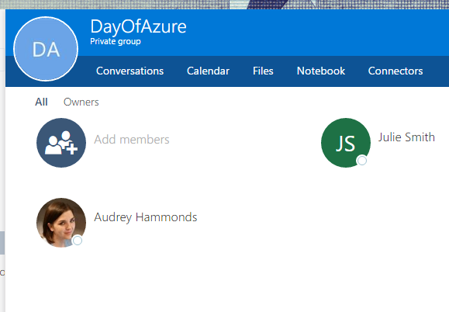
Creating Workgroup

Slide 45
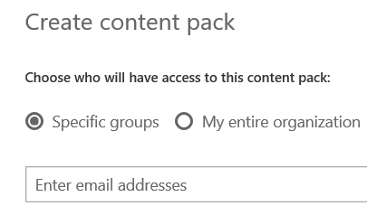
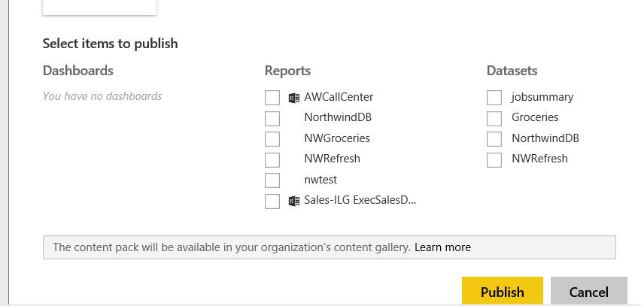
Content Packs
Internal Only
All PBI objects.
Package and share
Folks can edit.
Notifications

Slide 46
Sharing and Security
To Distribute to non Power BI Users
Use Power BI Embedded—still Azure
(still reliant on the report published to PBI Service for refreshing)

Slide 47
Refreshing Reports
Azure will refresh automatically (acts like Direct Query)
Gateway will allow automatic refresh as well to On Premises
**keep in mind if you use Direct Query, then you can’t “model” the data in the PBI Desktop. If you need to add a column or measure, you have to do it in the original source.

Slide 48
Refreshing Reports
Schedule Refreshes in the Power BI Service.

Slide 49
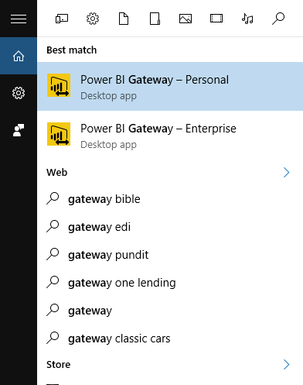
Gateways
Originally there were 2:
Personal Gateway--scheduled
Enterprise Gateway—for Direct
Now just the On Premises Data Gateway

Slide 50
Gateway Functions: Refreshing and Allowing Direct Query
Scheduled Refreshes are when you force Power BI service to re cache the data.
You also use the same gateway to encrypt the connection and allow the direct connect.
You don’t need gateway for Azure if there is no modeling.

Slide 51
Power BI on Mobile

Slide 52
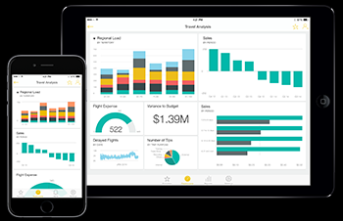
Mobile
User gets app.
Logs in.

Slide 53
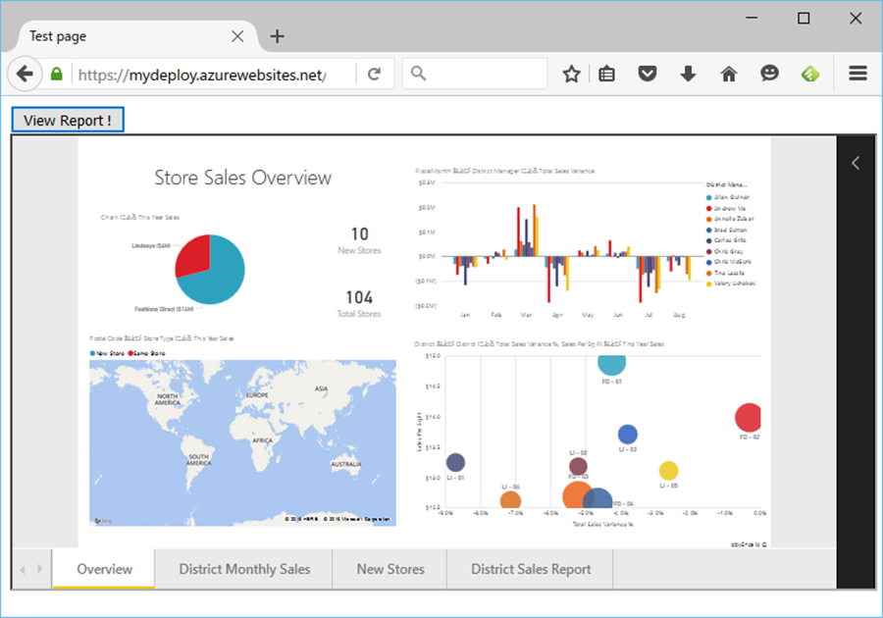
Embedded
We create web user.
We create web app
We create Power BI report
We embed the Power BI report in the app. In Azure

Slide 54
Is Power BI Cloud only?

Slide 55
Is Power BI Cloud only?
Pyramid Analytics has 3rd Party product.

Slide 56
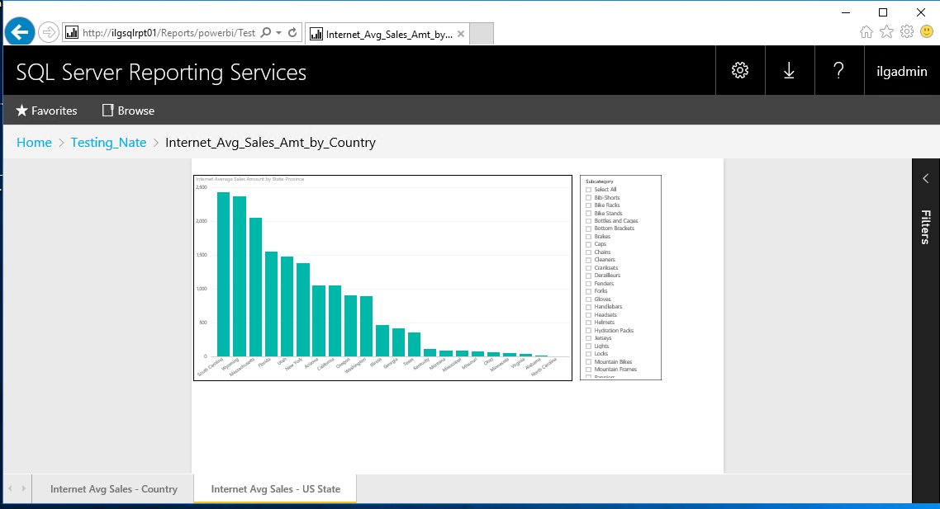
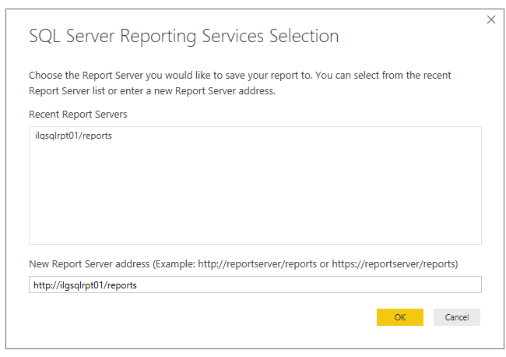
Power BI in SSRS 2016 Preview
In January, SSRS 2016 Preview arrived with Power BI Integrated.

Slide 57
Power BI in SSRS 2016 Preview
Only works with SSAS (MDX or Tabular) as source.
Users access Power BI through Report Portal not the Service
Do not believe you can embed the reports in a web app; can only give folks their reports through SSRS portal rather than PBI Service.
Guyinacube.com

Slide 58
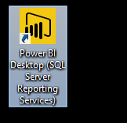
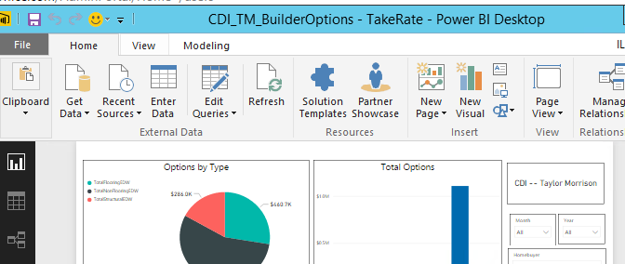
Power BI Desktop in SSRS 2016 Preview
Note SSRS in title bar
Note lack of Measurement and Modeling
Regular PBI Desktop

Slide 59
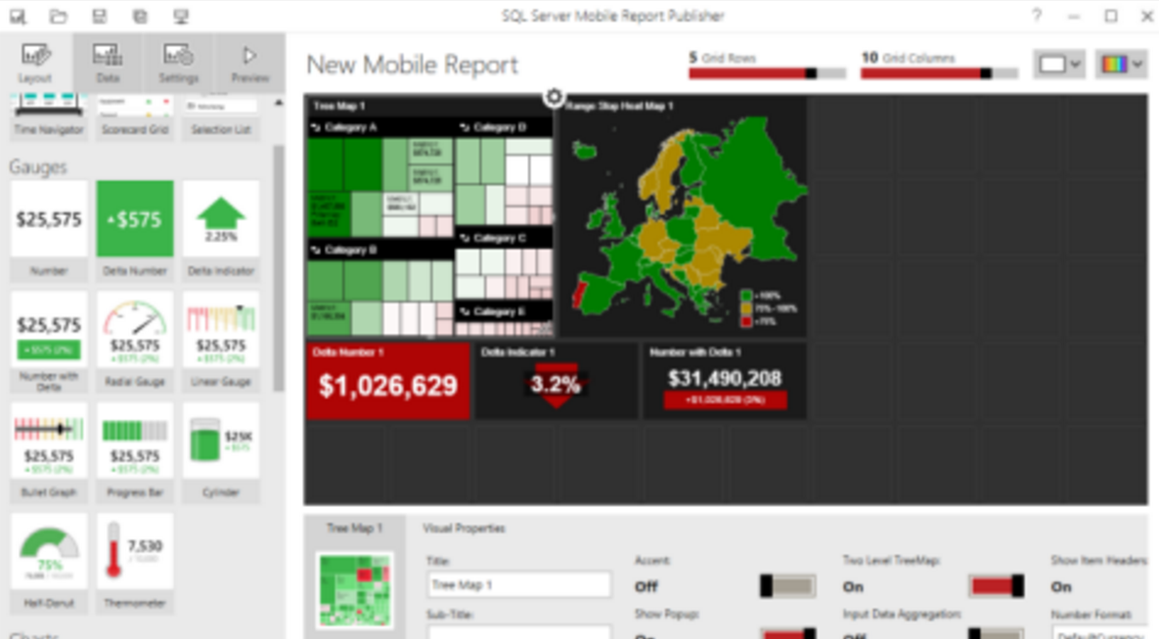
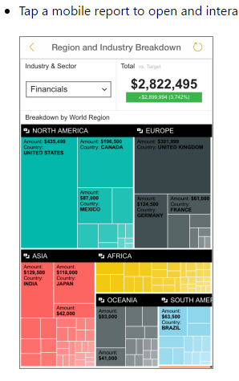
Power BI in SSRS 2016 Preview--Mobile
Yet another free tool to build mobile---SQL Server Mobile Report Publisher
Publish to server, renders by the connection you make to the SSRS server on Power BI App

Slide 60
Caveat
http://www.jenunderwood.com/2015/09/11/self-service-bi-fantasy/

Slide 61
Today’s Demo Data-- @dog_rates

Slide 62
Today’s Demo Data

Slide 63
Today’s Demo Data
https://github.com/dhmontgomery/personal-work/tree/master/dogrates

Slide 64
Today’s Demo Data

Slide 65
Today’s Demo Data

